Slide 1
Earnings impact on Spread in M&A
Kelvin Cheng

Slide 2
Earnings surprise impact on the likelihood of a takeover threat
Beating analysts’ expectation decreases the likelihood of being takeover
The higher the performance, the lower the chance
Conditional on posting a positive surprise, positing small surprise (within 5 cent) do not effect the chance of being takeover
For negative surprise posting, the magnitude of the surprise does not matter, but whether or not it is a small surprise (within 5 cents)
Firms that received takeover attempt are more likely to generate large earnings surprise
A possible explanation is to increase the premium

Slide 3
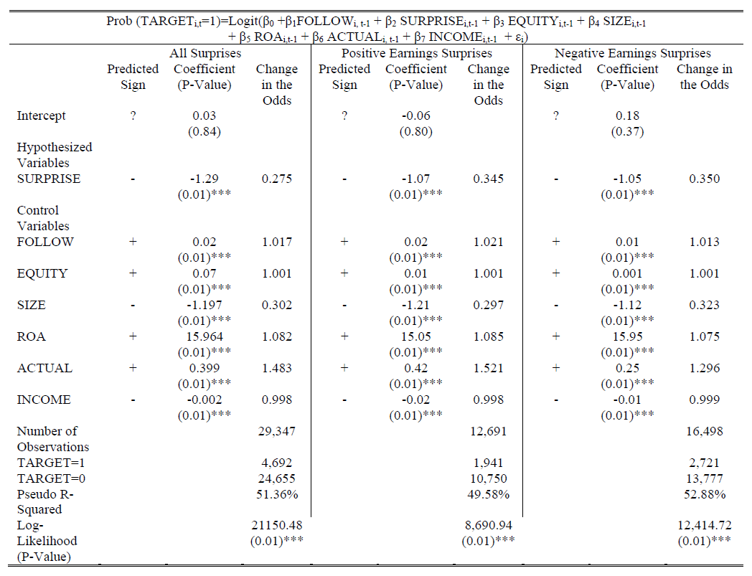
Earnings surprise impact on the likelihood of a takeover threat

Slide 4
Performance change in quite period
Earnings are depressed by higher expenses, rather than lower sales
Performance understatement appears to be driven by depressing operating cash flows, rather than negative accruals
Acquirers’ post-acquisition performance is boosted by transferring reserves created by targets’ performance understatement during the quite period

Slide 5
Data
M&A:
Dates: 1/1/2010 – 12/12/2017
Exchange: Publicly traded target stocks in US exchanges
Payment Type: Cash, Stock, Cash & Stock, Cash or Stock
Deal Size: at least 400 millions market size
Number of deals after filtering: 1990 deals
Other stocks:
Dates: 1/1/2010 – 12/12/2017
3280 stocks in NASDAQ
505 stocks in S&P500

Slide 6
Deal distribution

Slide 7
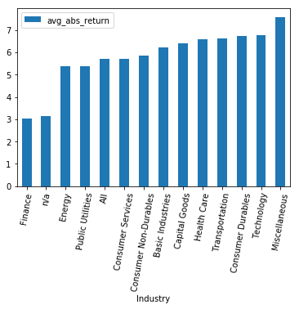
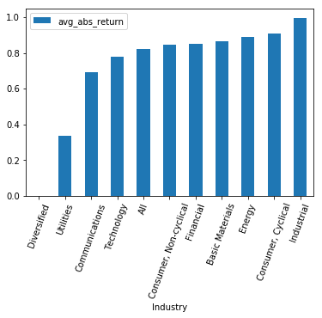
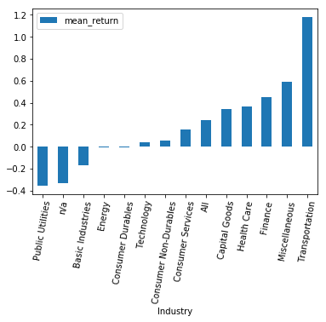
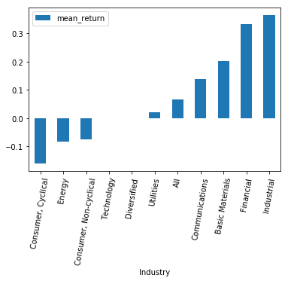
Average absolute return by sector on the earnings reaction day
NASDAQ
M&A (Cash Deal)
* Miscellaneous includes Business Services, Industrial Machinery/Components, Multi-Sector
companies, Office Equipment/Supplies/Services, Other Consumer Services, Publishing
** n/a are mostly ETFs and index funds

Slide 8
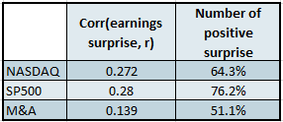
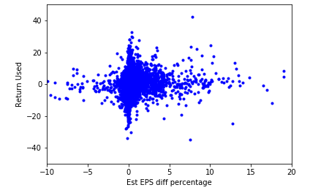
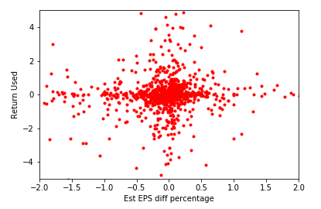
Correlation between earnings surprise and price return
SP500
M&A (Cash Deal)

Slide 9
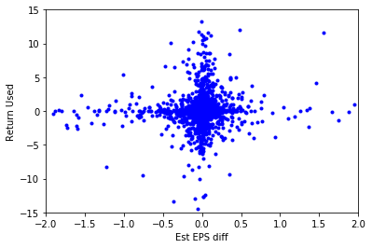
Correlation between earnings surprise and price return
SP500
M&A

Slide 10
Correlation between earnings surprise and price return - continue
NASDAQ
Industry | Corr(EPS surprise, return)
Health Care | 0.170750
Energy | 0.189915
n/a | 0.202246
Public Utilities | 0.221317
Transportation | 0.261078
Technology | 0.264141
Miscellaneous | 0.278165
Consumer Services | 0.298805
Basic Industries | 0.311853
Finance | 0.348193
Consumer Durables | 0.389989
Capital Goods | 0.406951
Consumer Non-Durables | 0.407607
M&A
Industry | Corr(EPS surprise, return)
Diversified | -0.5
Energy | 0.011672
Utilities | 0.057848
Consumer, Non-cyclical | 0.070744
Communications | 0.141943
Consumer, Cyclical | 0.159801
Basic Materials | 0.16364
Industrial | 0.165568
Financial | 0.207584
Technology | 0.310322
* Miscellaneous includes Business Services, Industrial Machinery/Components, Multi-Sector
companies, Office Equipment/Supplies/Services, Other Consumer Services, Publishing
** n/a are mostly ETFs and index funds

Slide 11
References
Spring-loading when no one is looking? Earnings and cash flow management around acquisitions – Shuping Chen, Jake Thomas, Frank Zhang
Earnings Surprises and Takeover Targets – Davit Adut, Doina Chichernea, Anthony Holder, Haim Kassa

